Slide 1

INSTITUTE-UNIVERSITY INSTITUTE OF SCIENCES
DIVISION – CHEMISTRY/MATHEMATICS
Bachelor of Science (B.Sc. Medical/Non- Medical)
Subject Name – Fundamental of Computer Programming in C
Subject Code – CST-392
Presented by:-
Er.Sumit Malhotra
Assistant Professor,CSE
Introduction of Computer
DISCOVER . LEARN . EMPOWER

Slide 2
Introduction of computer
Course Outcome
CO Number | Title | Level
CO1 | Become familiar to computing environment & it’s areas. | Remember
CO2 | Learn the syntax and usage of C programming language constructs | Remember, Understand
CO3 | Understand the program development process and solve problems for improving their coding skills. | Understand, Apply
Will be covered in this lecture

Slide 3

Definition: Computer
Computer is an electronic device that can perform a variety of operations in accordance with a set of instructions called program.
The term ‘computer is derived from the term ‘computare’, this means to calculate.
It takes raw data as input from the user and processes these data under the control of set of instructions (called program) and gives the result (output) and saves output for the future use.
It can process both numerical and non-numerical (arithmetic and logical) calculations.

Slide 4
Classification of computers
Computers differ based on their data processing abilities.
They are classified according to
purpose,
functionality and
size.

Slide 5
On the basis of purpose
Computers are classified as follows:
General purpose computers
designed to perform a range of tasks. They have the ability to store numerous programs, but lack in speed and efficiency.
Specific purpose computers
designed to handle a specific problem or to perform a specific task. A set of instructions is built into the machine.

Slide 6
On the basis of functionality
According to functionality, computers are classified as :
Analog Computer:
It uses continuous physical phenomena such as electrical, mechanical, or hydraulic quantities to model the problem being solved.
Digital Computer:
A computer that performs calculations and logical operations with quantities represented as digits, usually in the binary number system.
Hybrid Computer (Analog + Digital):
A combination of computers those are capable of inputting and outputting in both digital and analog signals.
A hybrid computer system setup offers a cost effective method of performing complex simulations.

Slide 7
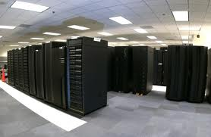
On the basis of size
On the basis of size, computers are classified as follows:
Super Computer
The fastest and most powerful type of computer.
very expensive and are employed for specialized applications that require immense amounts of mathematical calculations.
For example, weather forecasting requires a supercomputer.
Other uses of supercomputers include animated graphics, nuclear energy research, and petroleum exploration.

Slide 8
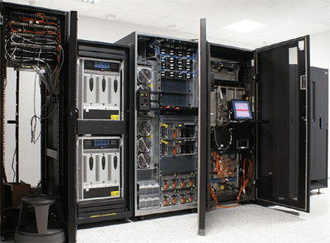
2. Mainframe Computer
A very large and expensive computer capable of supporting hundreds, or even thousands, of users simultaneously.
Mainframes are more powerful than supercomputers because they support more simultaneous programs.
But supercomputers can execute a single program faster than a mainframe.
Difference between a supercomputer and a mainframe is that a supercomputer channels all its power into executing a few programs as fast as possible, whereas a mainframe uses its power to execute many programs concurrently.

Slide 9
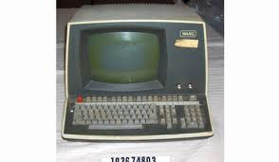
3. Mini Computer
A midsized computer.
In size and power, minicomputers lie between workstations and mainframes.
A minicomputer is a multiprocessing system capable of supporting from 4 to about 200 users simultaneously.

Slide 10

4. Micro Computer or Personal Computer
Desktop Computer: a personal or micro-mini computer sufficient to fit on a desk.
Laptop Computer: a portable computer complete with an integrated screen and keyboard. It is generally smaller in size than a desktop computer and larger than a notebook computer.
Palmtop Computer/Digital Diary /Notebook /PDAs: a hand-sized computer. Palmtops have no keyboard but the screen serves both as an input and output device.

Slide 11
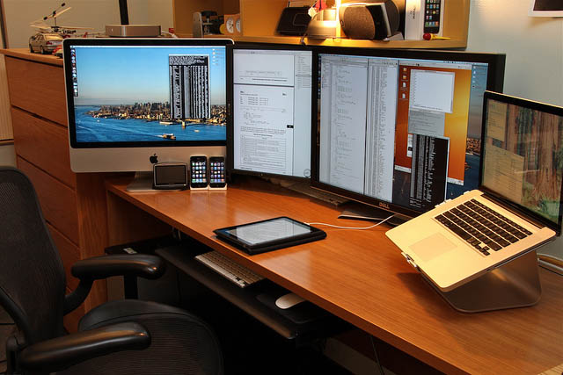
Workstation
A terminal or desktop computer in a network. In this context, workstation is just a generic term for a user's machine (client machine) in contrast to a "server" or "mainframe.“

Slide 12
Features:
Transistor replaced the bulky Vacuum tubes in the first generation computer.
Processing speed is faster than First Generation Computers (Micro Second).
Manufacturing cost was also very low.
The size of the computer got reduced considerably.
The input and output devices were faster.
Example: IBM 1400 and 7000 Series, Control Data 3600 etc.

Slide 13
THANK YOU

